Slide 1
Pedestrian Attribute Recognition
COMPUTER VISION · ASSIGNMENT 2
UPAR Challenge 2027, Track 1 (WACV RWS)
Adina Faraz (23K-0008) and Syed Muneeb Ur Rehman (23K-0038)
Notes:
Introduce the team and the task: predicting 40 yes/no attributes of a pedestrian from one image.

Slide 2
The task
Look at one cropped image of a person and say which of 40 attributes are present.
Examples: gender, age group, hair length, clothing type and colour, bag, hat.
Each attribute is a yes/no answer, so this is multi-label classification.
Track 1 of the UPAR Challenge 2027, run on Codabench (competition 18180).
Test data is hidden and comes from different cameras than the training data.
UPAR Challenge Track 1
2
Notes:
Explain that the hidden test set is the main difficulty.

Slide 3
Data and metrics
Data
Metrics
UPAR Track 1 training set: 97,669 images, validation set: 33,407 images. It is built from PA100k, PETA and Market1501, with 40 shared attributes.
Mean accuracy (mA) over attributes, and instance-level F1.
The ranking score is the harmonic mean of the two, averaged over the three datasets. A prediction counts as positive when its probability is above 0.5.
Some attributes are not labelled in some source datasets, so those labels are skipped in the loss.
UPAR Challenge Track 1
3
Notes:
Mention that the score is called Avg on the leaderboard.

Slide 4
Our method
Part | What we did
Model | ConvNeXt-Small pretrained on ImageNet, fine-tuned with a 40-output head
Loss | Weighted binary cross-entropy that ignores missing labels, label smoothing 0.02
Training | AdamW, OneCycle schedule, bf16, EMA of weights, strong augmentation
Input size | Run 1: 256 x 128. Run 2: 320 x 160
Inference | Flip test-time augmentation and one tuned threshold per attribute
UPAR Challenge Track 1
4
Notes:
Trained on one RTX 3080 Ti laptop GPU. Thresholds were tuned on validation and folded into the model output so run.py stays simple.

Slide 5
Results on the hidden test set
Run 1 (256 x 128)
Run 2 (320 x 160), our best
Rank 1 on leaderboard
0.7565
0.7584
0.8000
More input resolution gave only +0.002, which is small and could be noise. The score is the leaderboard Avg.
UPAR Challenge Track 1
5
Notes:
Both runs are real Codabench submissions with status Finished.

Slide 6
Analysis: validation versus test
87.7
75.7
Validation score
Hidden test score
A gap of about 12 points means the model overfits to the training cameras.
Per-attribute thresholds tuned on validation help there but give less on the test set.
Rare attributes are harder, so we weighted the loss towards them.
UPAR Challenge Track 1
6
Notes:
Validation numbers are on a different scale from the leaderboard Avg, but the gap shows domain shift.

Slide 7
Challenges
Challenge | How we handled it
Domain shift | Strong augmentation, EMA weights, flip test-time augmentation
Class imbalance | Weighted loss and per-attribute thresholds
Missing labels | Masked loss that skips unlabelled attributes
Submission limits | 5 minute limit and only torch in the container, so we used torchvision
Windows setup | Python version, old driver (CUDA 11.8 build) and blocked packages
UPAR Challenge Track 1
7
Notes:
Mention the run.py bug where the image path was relative and how it was fixed.

Slide 8
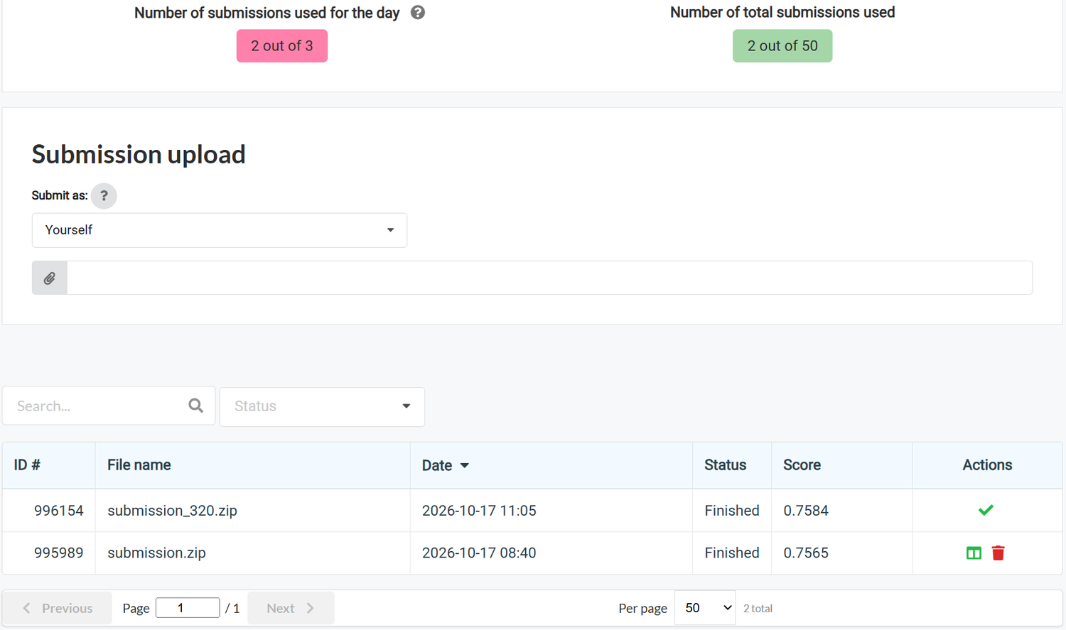
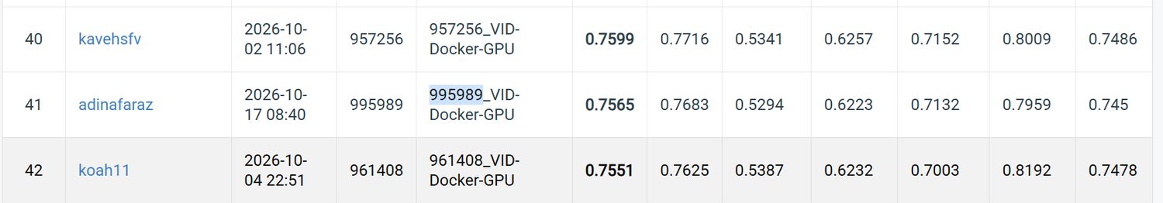
Proof of Codabench submission
Submissions page: both runs Finished
Leaderboard row for our team
UPAR Challenge Track 1
8
Notes:
Run 1 was ID for 0.7565; Run 2 is submission 996154 with 0.7584.

Slide 9
What we would improve
Train on more varied data and use stronger colour and camera augmentation to reduce the domain gap.
Try a larger backbone or an ensemble of two models.
Tune thresholds with a validation split that looks more like the test cameras.
Use attribute relations, for example hair length together with gender.
UPAR Challenge Track 1
9
Notes:
These are ideas, not tested results.

